Slide 1

Web Designer
Riya Shah

Slide 2
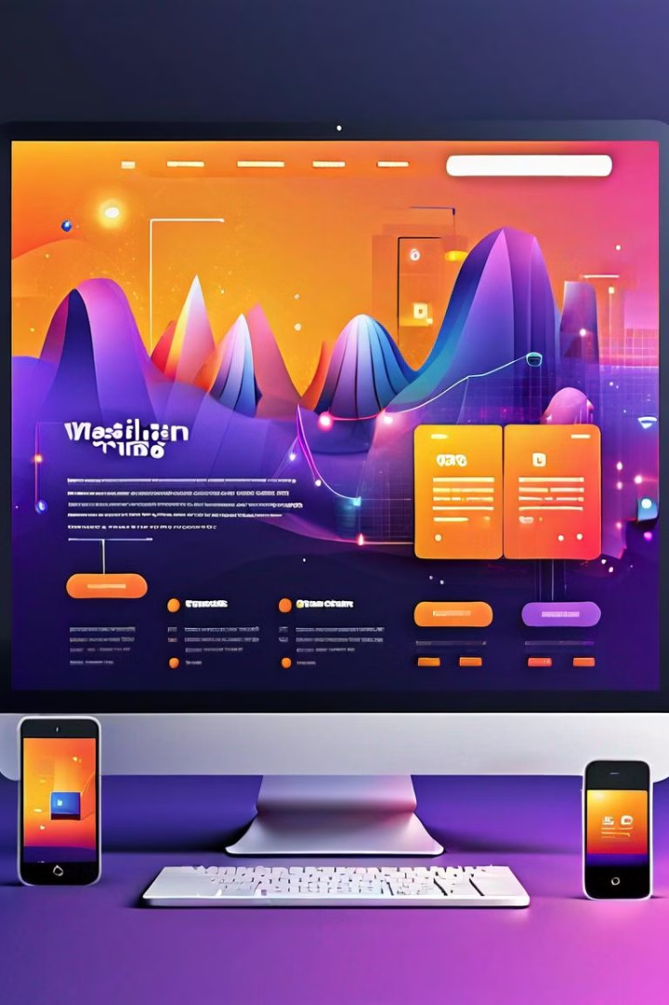
What is Web Designing?
The three most common types of web design are static web design, dynamic web design, and eCommerce web design.
Web design identifies the goals of a website and promotes accessibility for all users.
Web designing is the process of planning, conceptualizing, and implementing a website design that offers a great user experience.

Slide 3
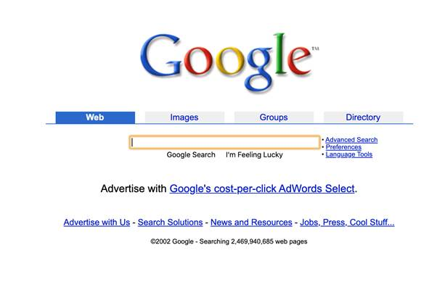
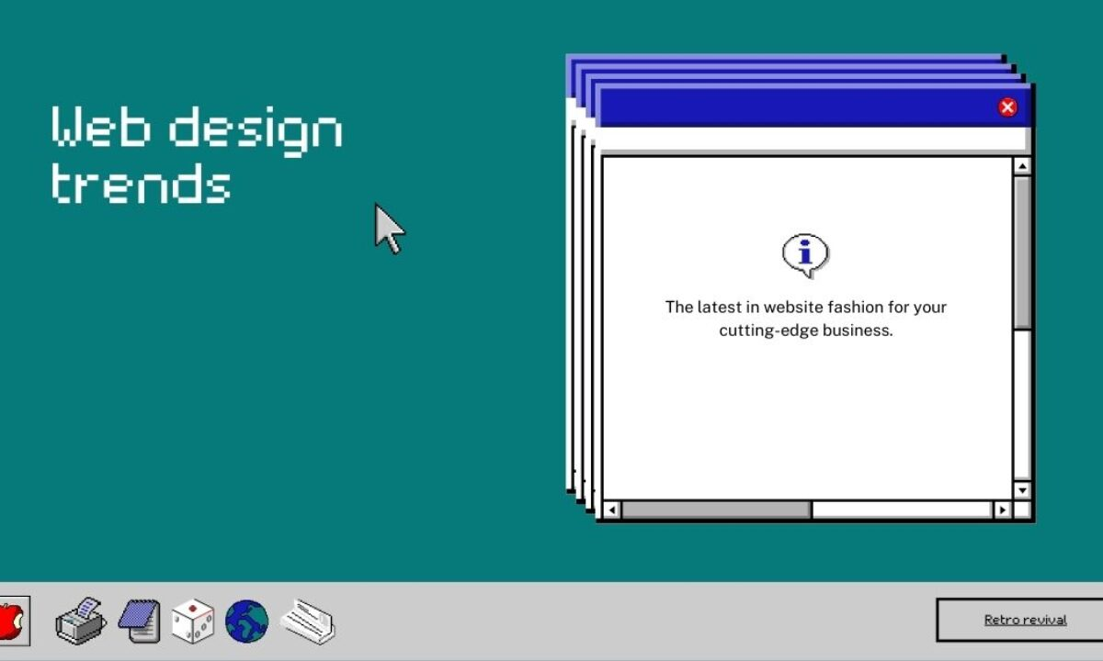
Early Trends in Web Designing
The early days of web design (1990-1995) - The first websites were text-based. They consisted of simple HTML code for headings, links, and paragraphs. There were no fancy graphics or multimedia elements
There are 5 stages of Web Design - Analysis, design, programming, testing & review, deployment, and maintenance.
Early sites were entirely text-based, with minimal images and no real layout to speak of other than headings and paragraphs. However, the industry progressed, eventually bringing us table-based designs, then Flash, and finally CSS-based designs.

Slide 4
Upcoming trends in Web Designing
1
Scrolling Animations
2
Micro-Interactions
Seamless transitions and visual storytelling
Delightful and subtle user interactions
3
Micro-Animations
4
Dynamic Cursors
Small, delightful animations to enhance UX
Unique and responsive cursor experiences
5
Interactive 3D Models and Content
6
Gamified Design
Incorporating game-like elements for increased engagement
Immersive and engaging 3D experiences

Slide 5




Upcoming Trends in Web Designing
Text-Only Hero Images
Custom Illustrations
Full-Page Headers
Dark Mode
Sophisticated dark themes for enhanced readability and style.
Impactful text-only hero images for a clean, focused look.
Unique, hand-drawn illustrations to express brand identity.
Immersive, full-screen hero sections for maximum impact.

Slide 6
Upgradation in Web Designing
There are many skills to upgrade in web designing, but mainly these update is going on in Web Designing.
Cloud Computing
Automated Code Reviews
Web 3
Advanced AI
Progressive Web Applications
Modern Languages to Stay Trending
Low Code/No-Code Development
Motion UI for User Experience
Technologies to Strengthen Cyber Security
Single-Page Websites
API First Approach
Mobile Optimized Website
Serverless Architecture
5G
Advanced IoT

Slide 7
Career Aspirations in Web Designing
Graphic Designer
User Interface Designer
Skilled in design principles and digital asset creation
Overlap with web designers, share goal of positive UX
Leverage Photoshop, Illustrator, and other tools
Develop interactive interfaces to improve customer satisfaction
Become an expert graphic designer as a web designer
Learn visual hierarchy at a reputable web design institute

Slide 8
Design Analyst and the Future of Web Design
Design Analyst
Rectifying Design Issues
Transitioning Roles
Responsible for the visual structure of web pages, creating and refining designs.
Web designers can work as design analysts, leveraging their creative skills.
Leveraging web design training to solve design problems and create engaging experiences.
Rapid Digital Transformation
Increased Sales
Demand for Web Designers
62% of companies saw sales increase with responsive, engaging websites.
Every company needs a compelling website to showcase products and services.
Huge need for skilled web designers to create digital experiences.

Slide 9

Learning Web Designing at TOPS Technology
At TOPS Technology, I have been learning the essential web design technologies - HTML, CSS, JavaScript, jQuery, and Bootstrap. These tools empower me to create dynamic, responsive, and visually appealing websites.

Slide 10

Learning at TOPS Technology
HTML & HTML5
1
Structuring website and web pages
2
CSS
Designing and styling attractive websites
JavaScript, jQuery, Bootstrap
3
Adding interactivity and responsive design

Slide 11




Why Web Designing?
I chose this field because it enables me to showcase my creativity.
I had an early interest in designing so I got attracted to this course which can help me achieve my dreams.
I believe by choosing the career in web design and learning about this field in depth can help me improve myself and make me more dynamic and creative.
From market perspective, it is an era of Digitalization.
Everyday new websites and applications are built so there is a boom in the demand of web designer’s .
It is also one of the reason why I choose web design ….

Slide 12


Any Questions??

Slide 13

Thank You

